Slide 1
Friends of The Monona Senior Center
Presented February 17, 2022
2021 - A Year In Review

Slide 2
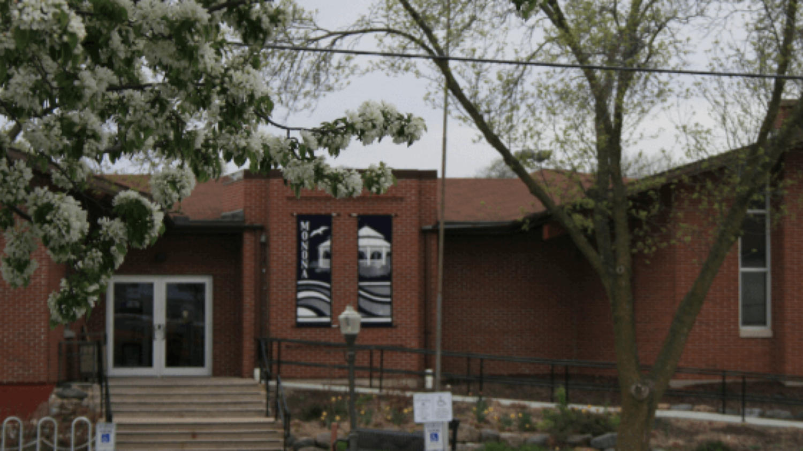
The Friends Group’s Members and Mission

Slide 3
Recognition of the Board of Directors in 2021
Kathy Thomas (President)
Susan Manning (Vice President)
Judy Runk (Treasurer)
Dan Eklof (Secretary)
Molly Grupe (with Dan Eklof, Website)
Diane Mikelbank (Senior Center Director)
Jackie Amati
Kathy Bell
Dean Bowles
Sandy Homburg
Dave Joranson
Laura Nielsen
Stan Nielsen

Slide 4
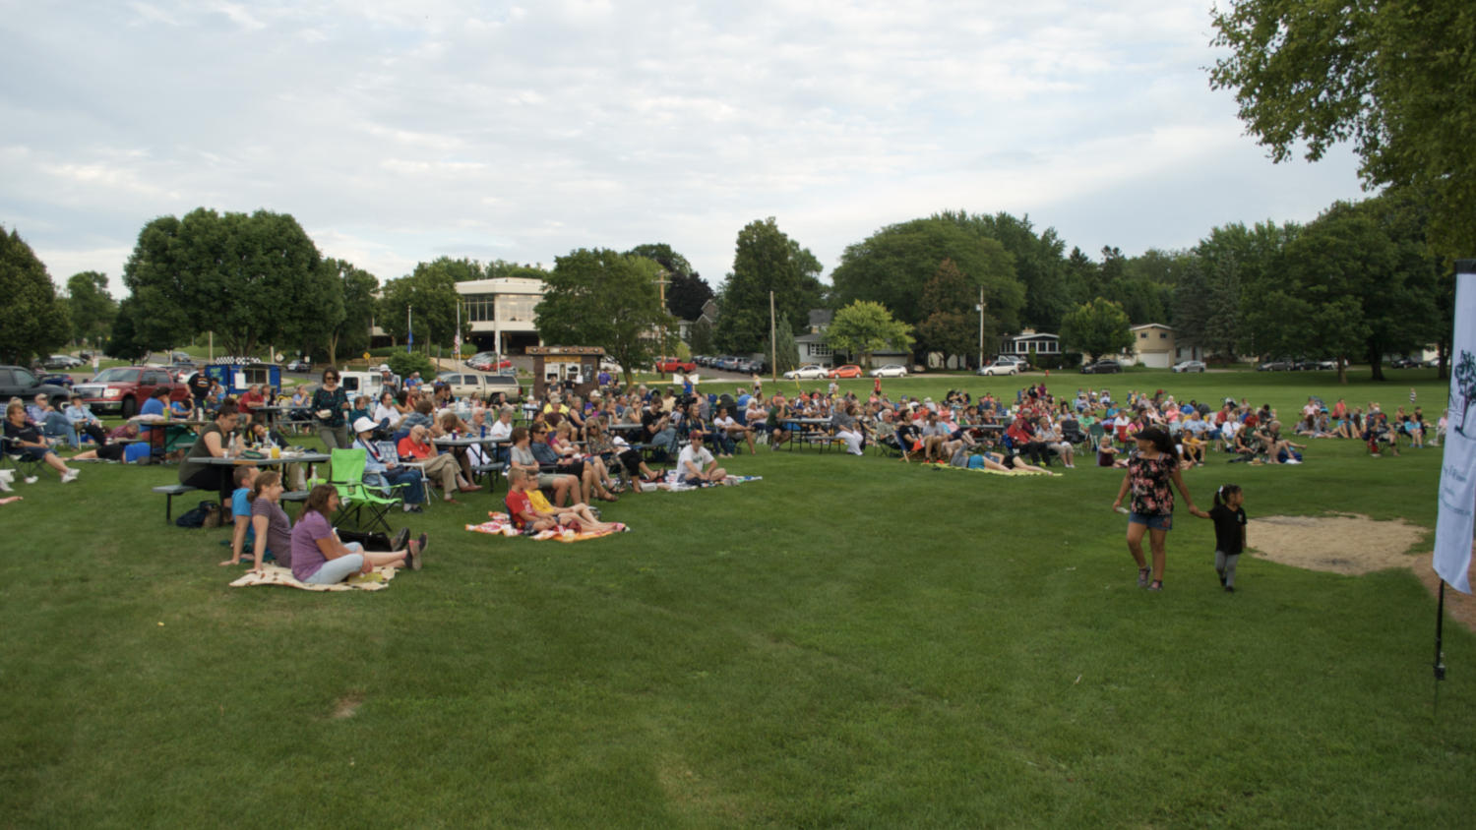
“The Friends of the Monona Senior Center promote and support the Monona Senior Center in enriching the lives of adults 50 and better.”
Mission of the Friends of the Monona Senior Center

Slide 5
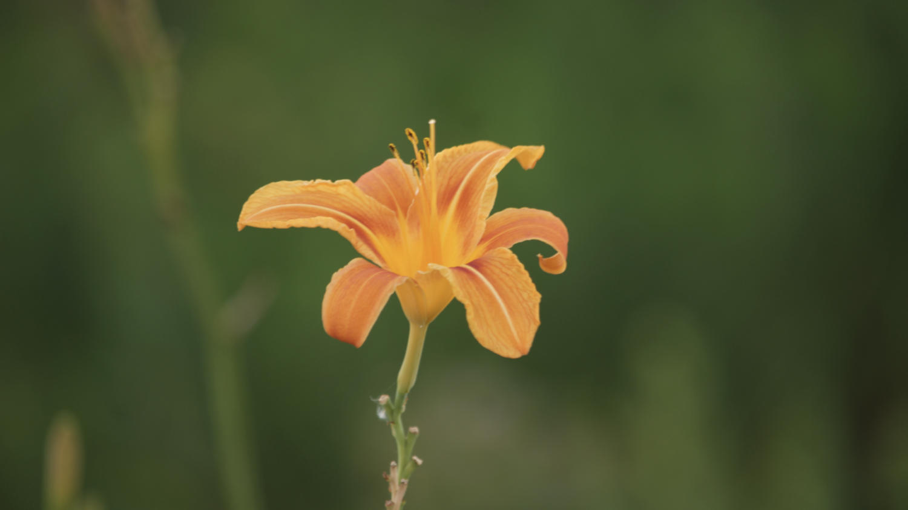
Financial Position

Slide 6
Financial Support will be used for…
…Enhancing existing programs and services to enrich the lives of older adults.
…Providing scholarships to seniors who would not otherwise be able to participate due to financial challenges.
…Helping to expand programs to meet the changing needs of seniors.
…Promoting knowledge of and support Senior Center activities and programs.

Slide 7
Revenues and Balances
Year | Revenues
2021 | $33,191
2020 | $18,722
2019 | $20,128
2018 | $19,146
2017 | $17,106
Date | Balance | CD | Total
12/31/21 | $22,074 | $61,172 | $83,246
12/31/20 | $26,503 | $32,036 | $58,539
12/31/19 | $11,050 | $30,617 | $41,667
12/31/18 | $21,855 | $15,039 | $36,894
12/31/17 | $10,812 | $15,000 | $25,812

Slide 8
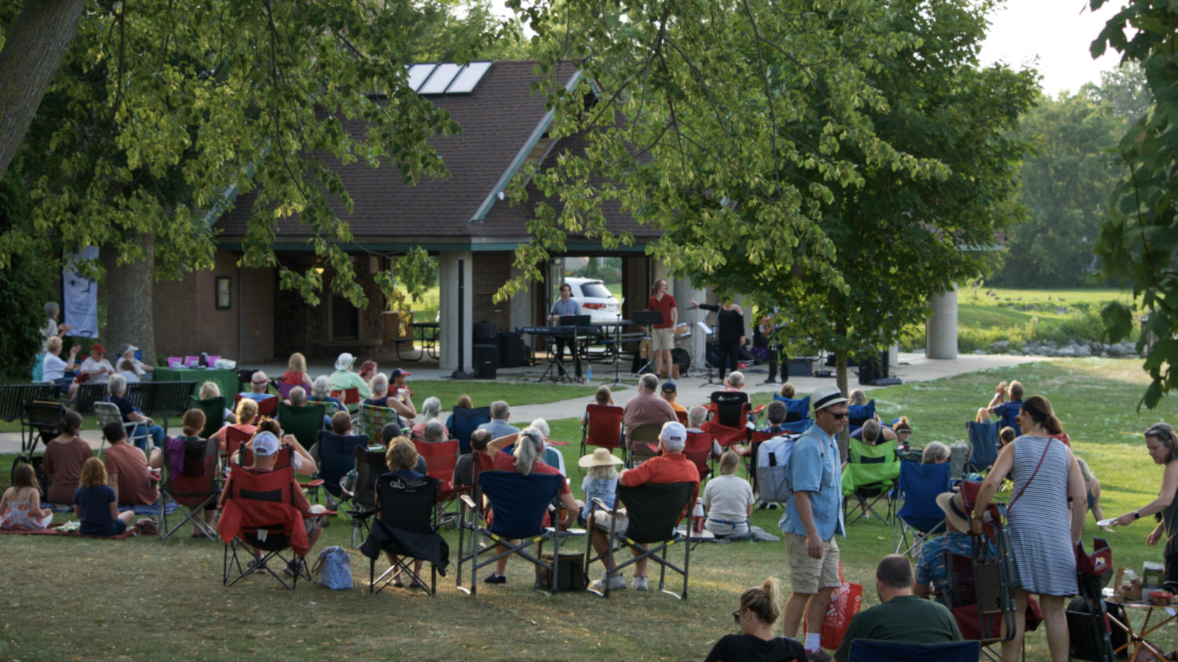
Membership

Slide 9
Being a member means you…
…Receive your newsletter in the mail!
…Help out a great community!
…Be part of a great group of folks that want to help each other as much as possible!
…Help fund programs and functions of your local senior center!
…Give back to a group that gives so much to the senior center!
Community support is integral to our existence!
You can also join our great group of volunteers!

Slide 10
Memberships By Year
Year | Memberships | Lifetime
2021 | 433 | 96
2020 | 431 | 67
2019 | 409 | 58
2018 | 441 | 44
2017 | 466 | 35
2016 | 464 | 28
2015 | 489 | 22
2014 | 372 | 10
2013 | 333
2012 | 349
2011 | 348
2010 | 303

Slide 11
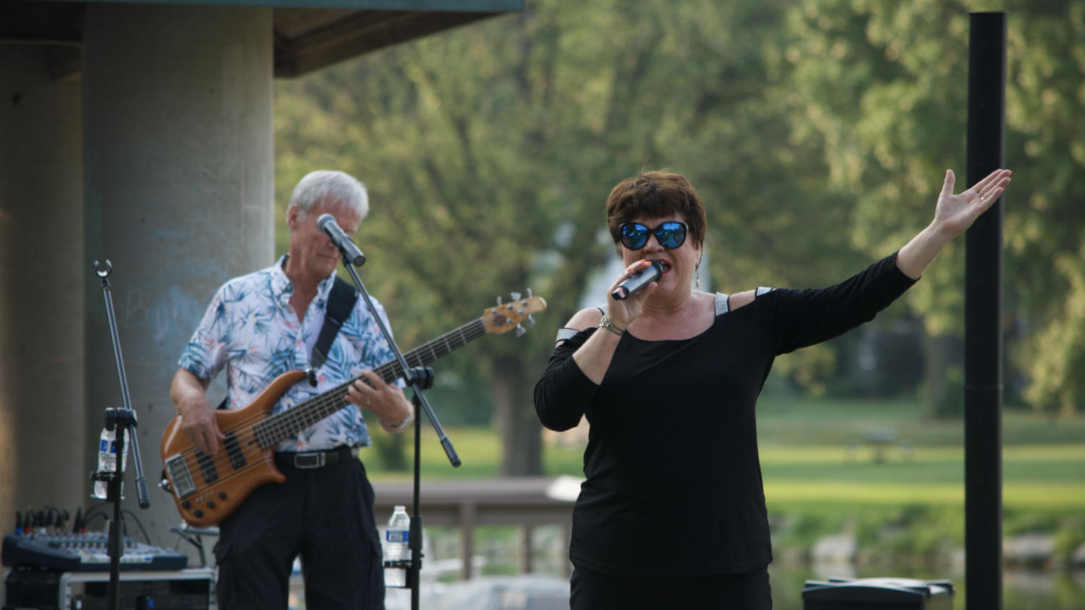
Events

Slide 12
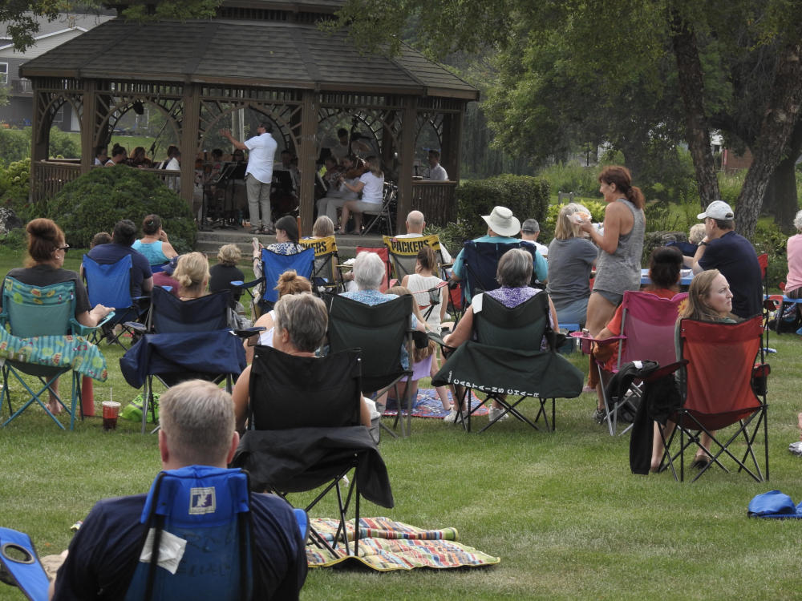
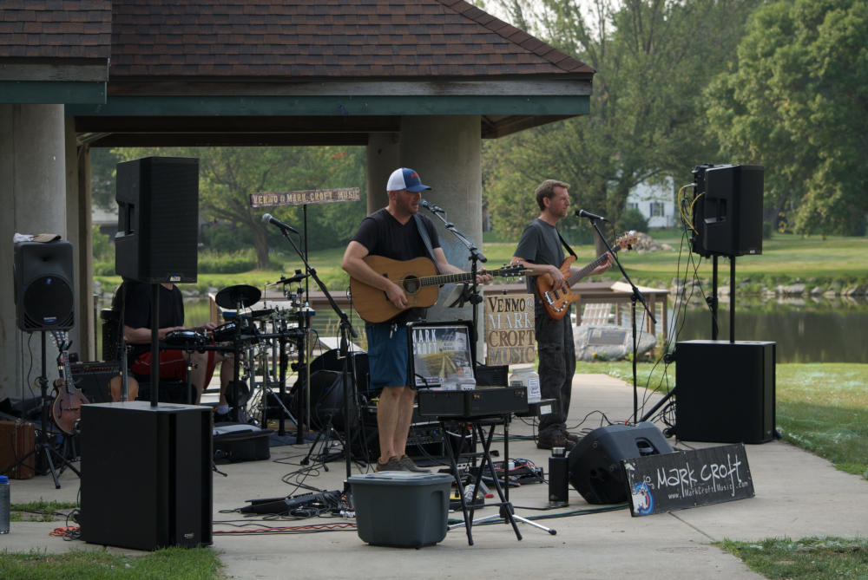
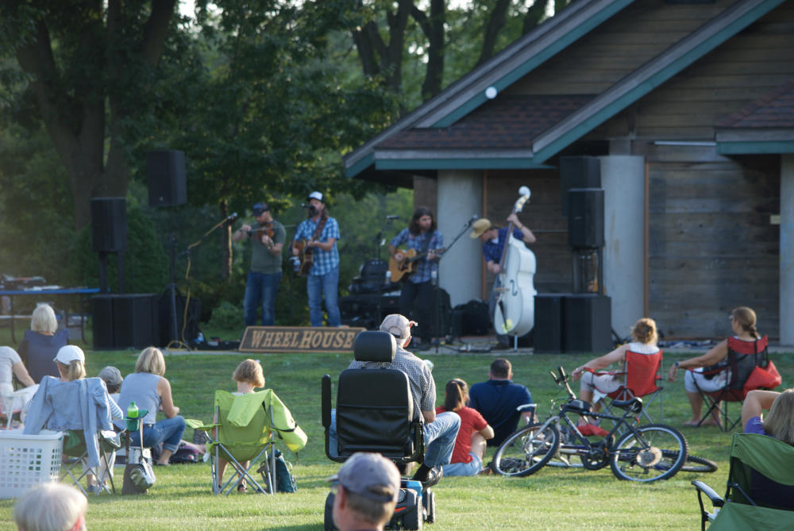
Summer Concerts
We relaxed to an evening filled with friends, family, and great music!

Slide 13
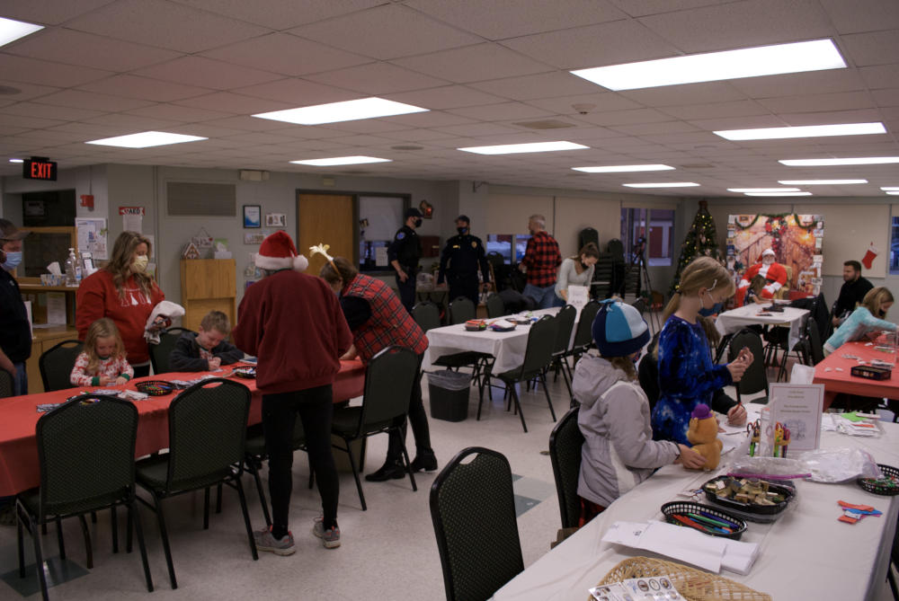
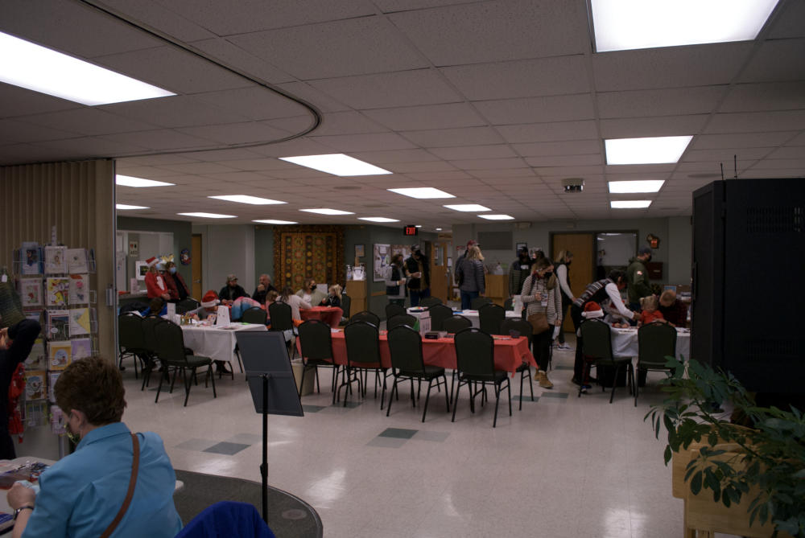
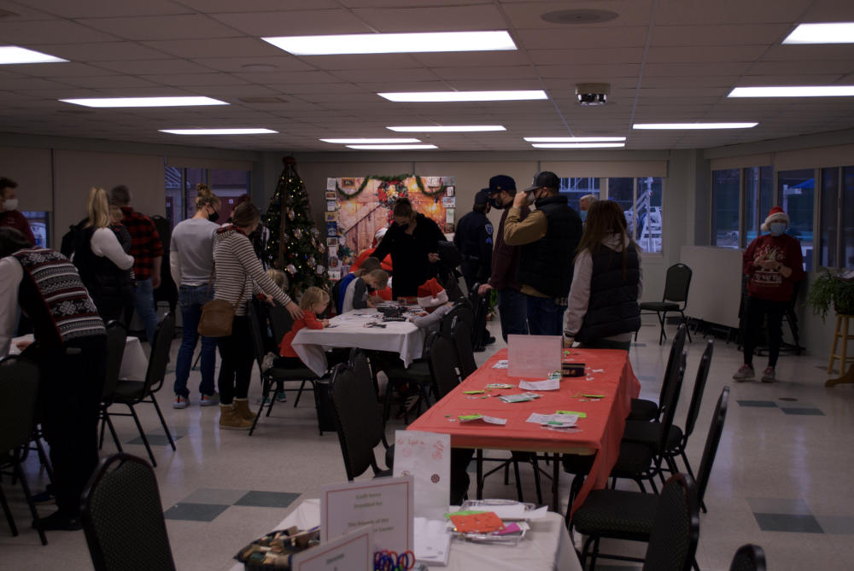
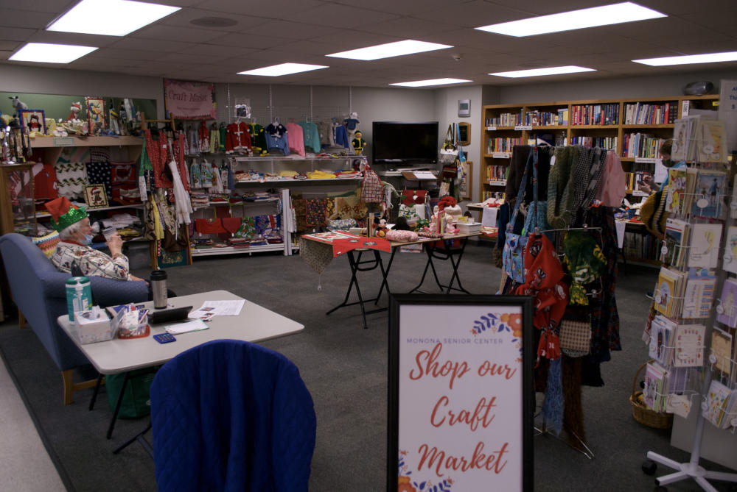
Santa’s Workshop
This year we held a workshop, with a slightly different name and twist on our classic “Santa’s Workshop”, where kids can make fun and exciting ornaments and decorations!

Slide 14
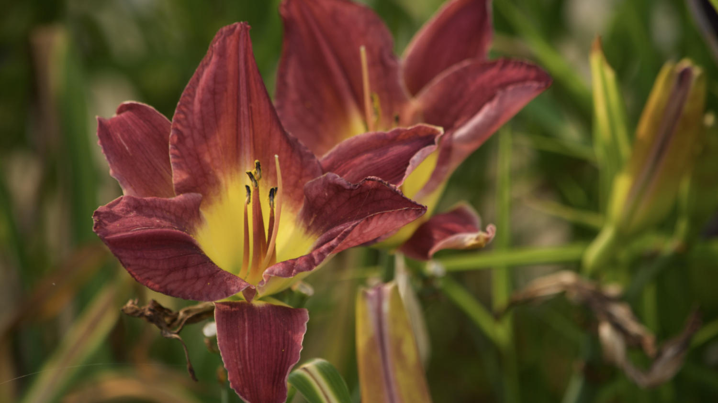
Achievements

Slide 15
Things We’ve Done This Past Year
Purchased a second zoom account to accommodate more virtual meetings and groups!
Hosted a drive thru contribution for Earth Day!
Started an iPad leading program!
Took part in the senior center’s open house, promoting the friends group with information and flashlights!
Our very own board members offer different programs through the senior center:
Sandy Homburg offers a virtual meditation group with great reviews!
Dan Eklof offers a virtual technology assistance program!

Slide 16
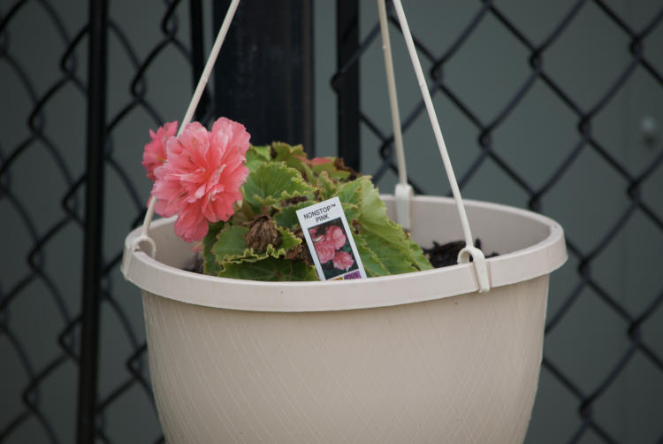
Garden Committee Work
Our Garden Committee has done a fantastic job at make our building we call home beautiful! Please enjoy the next few slides with Kathy Bell in our memories.

Slide 17
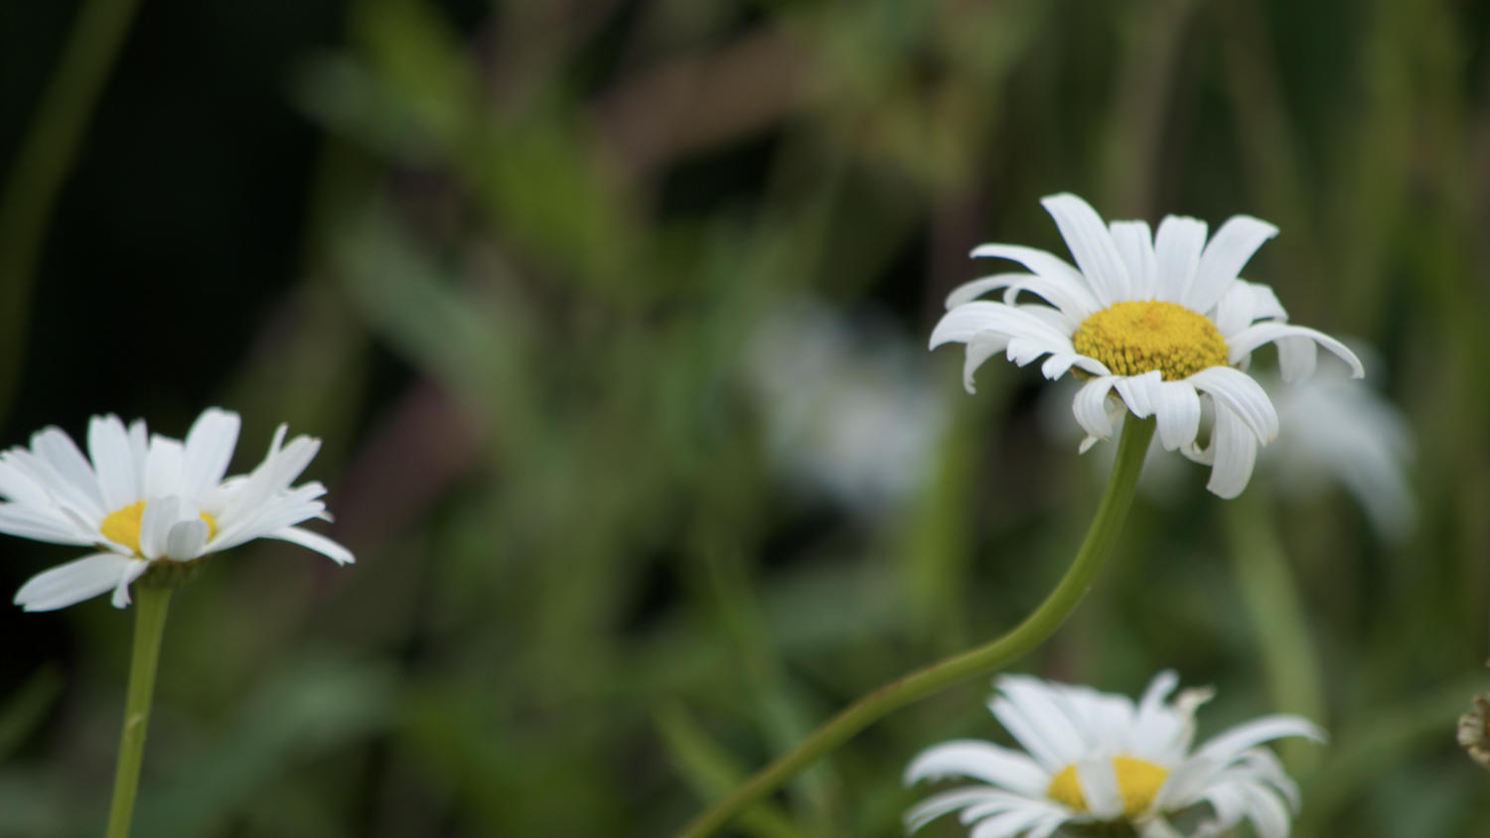

Slide 18
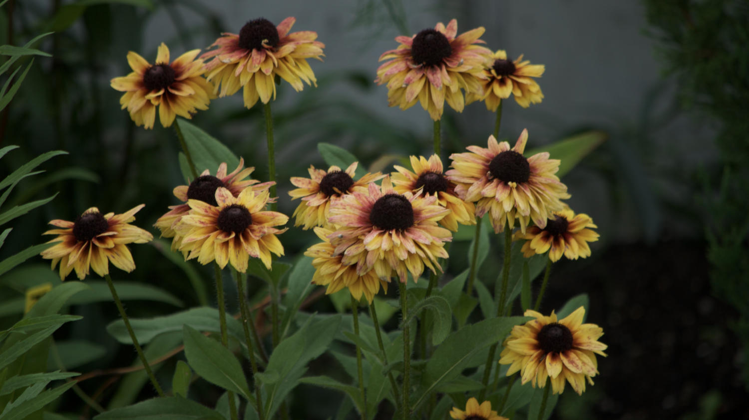

Slide 19
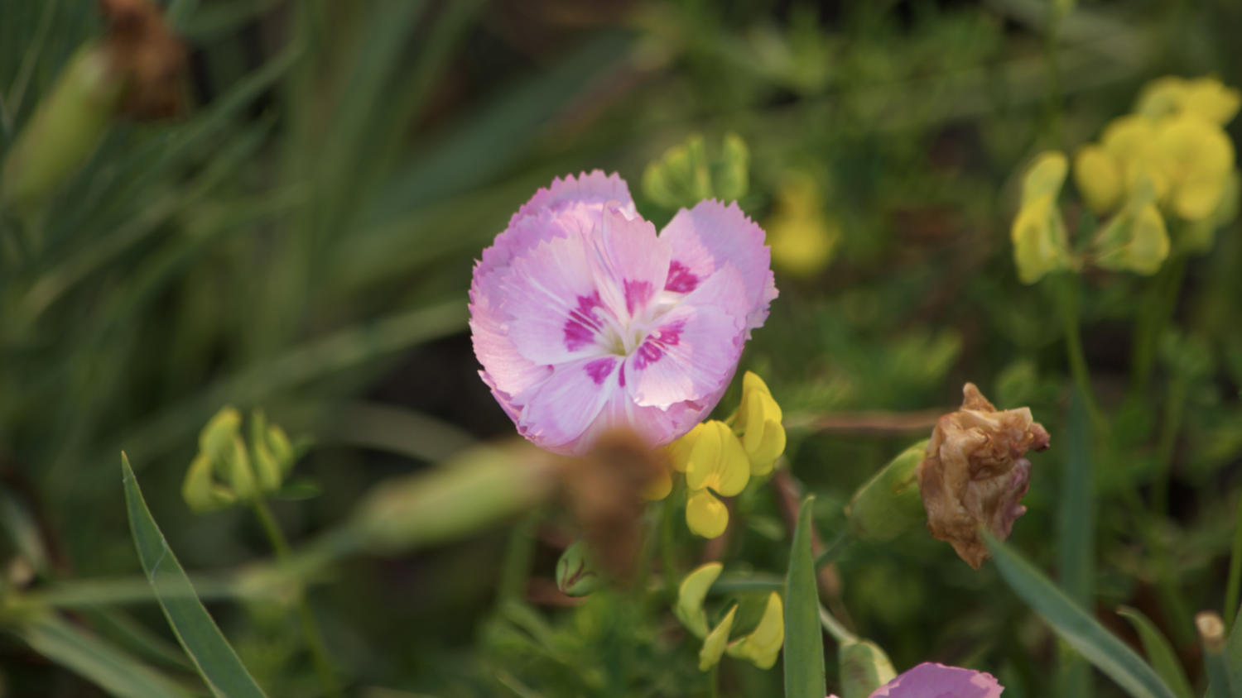

Slide 20
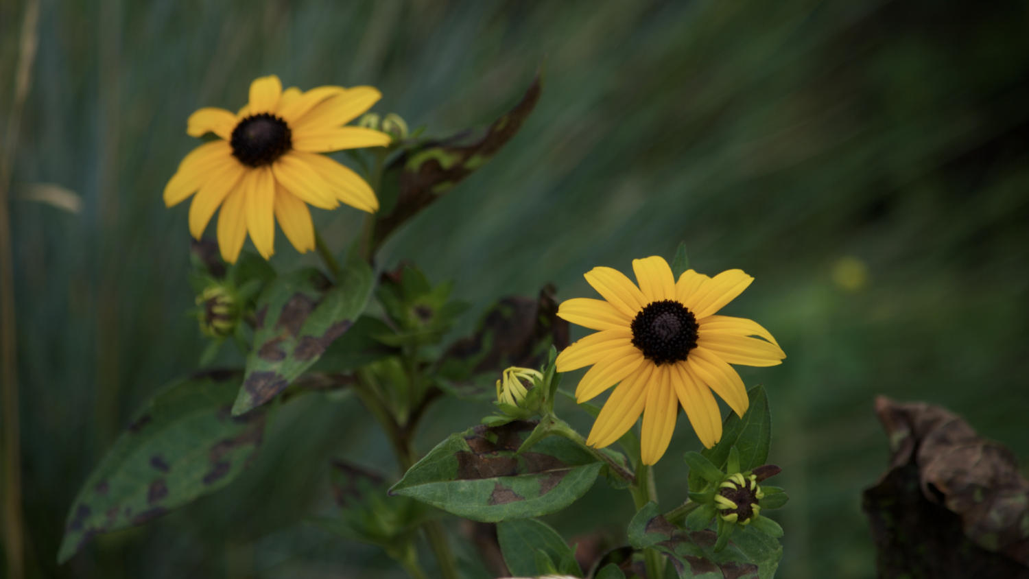

Slide 21
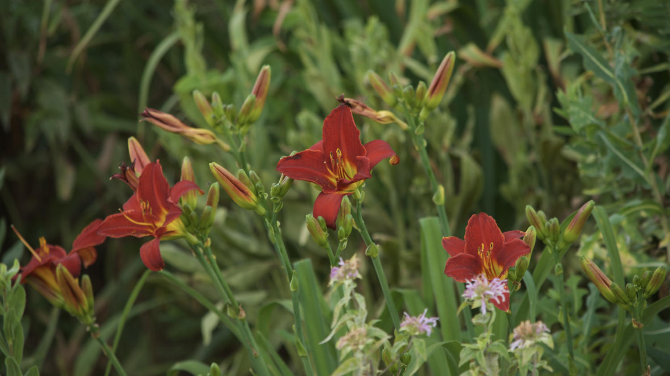

Slide 22
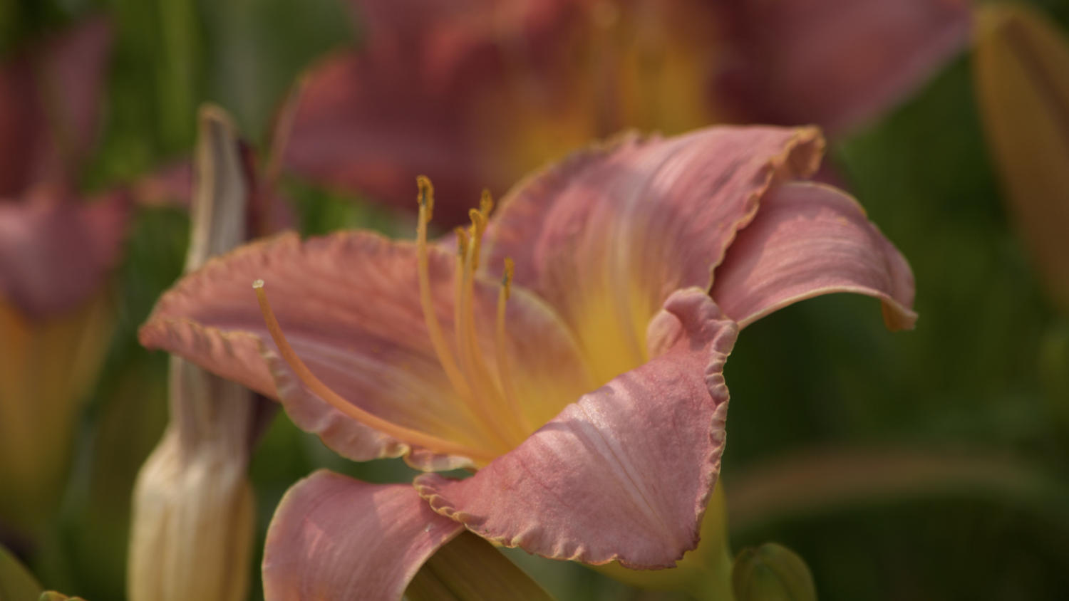

Slide 23
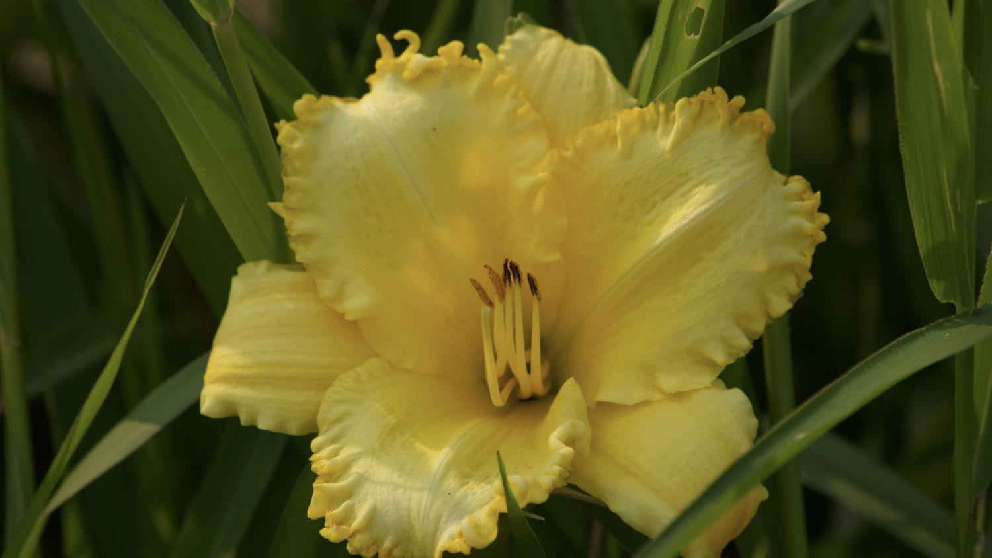

Slide 24
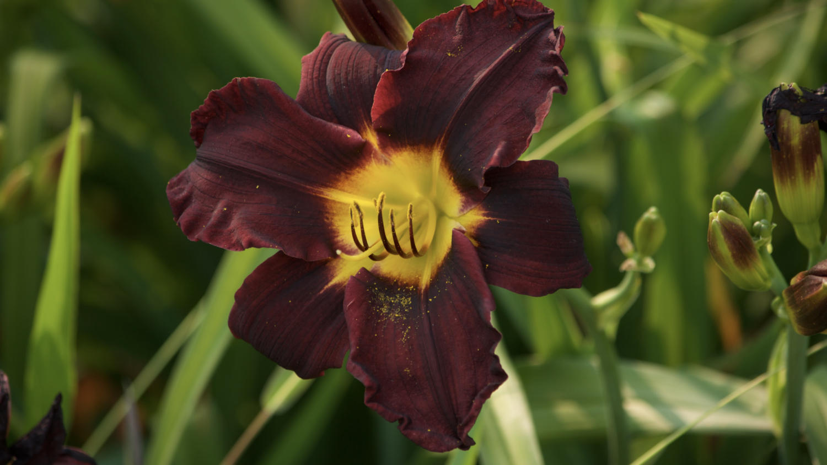

Slide 25
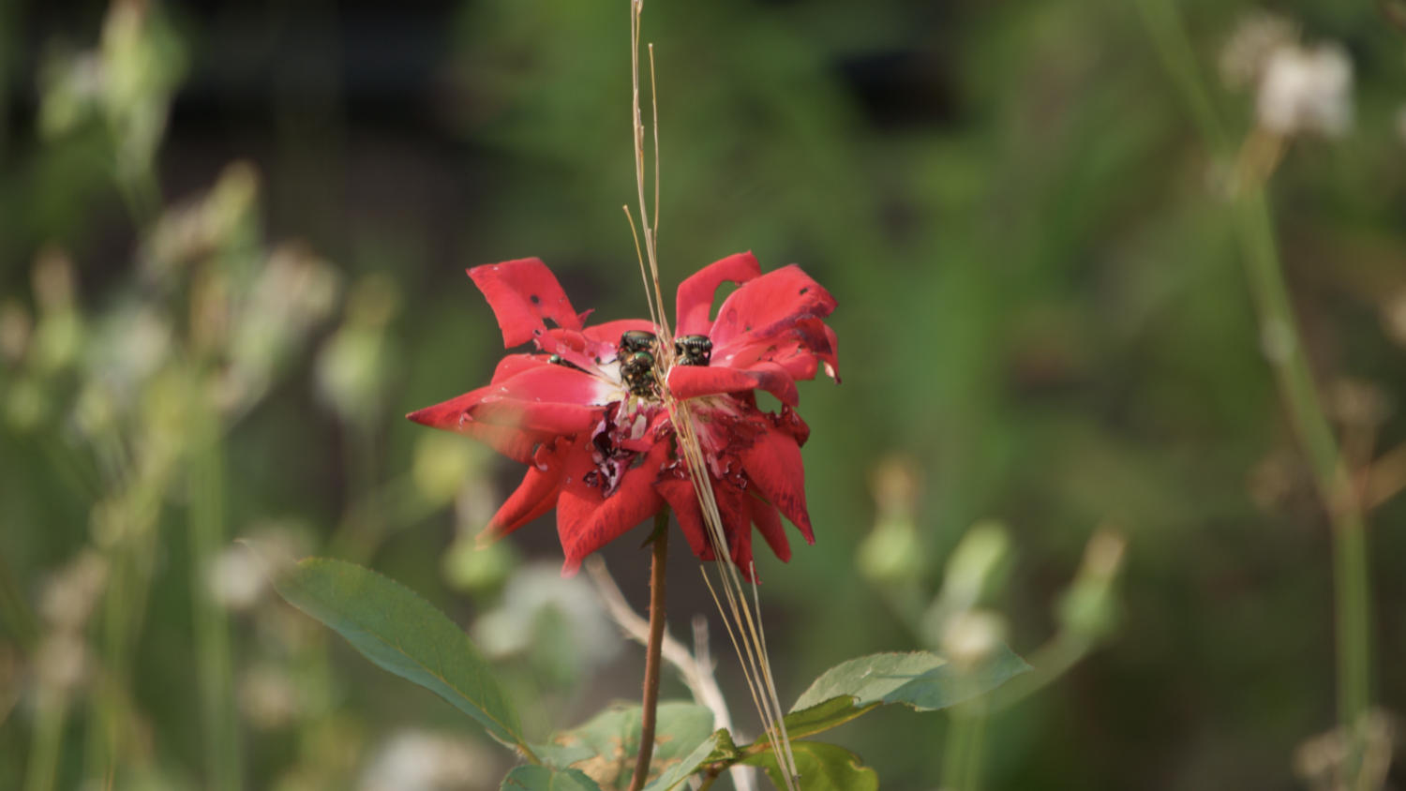

Slide 26
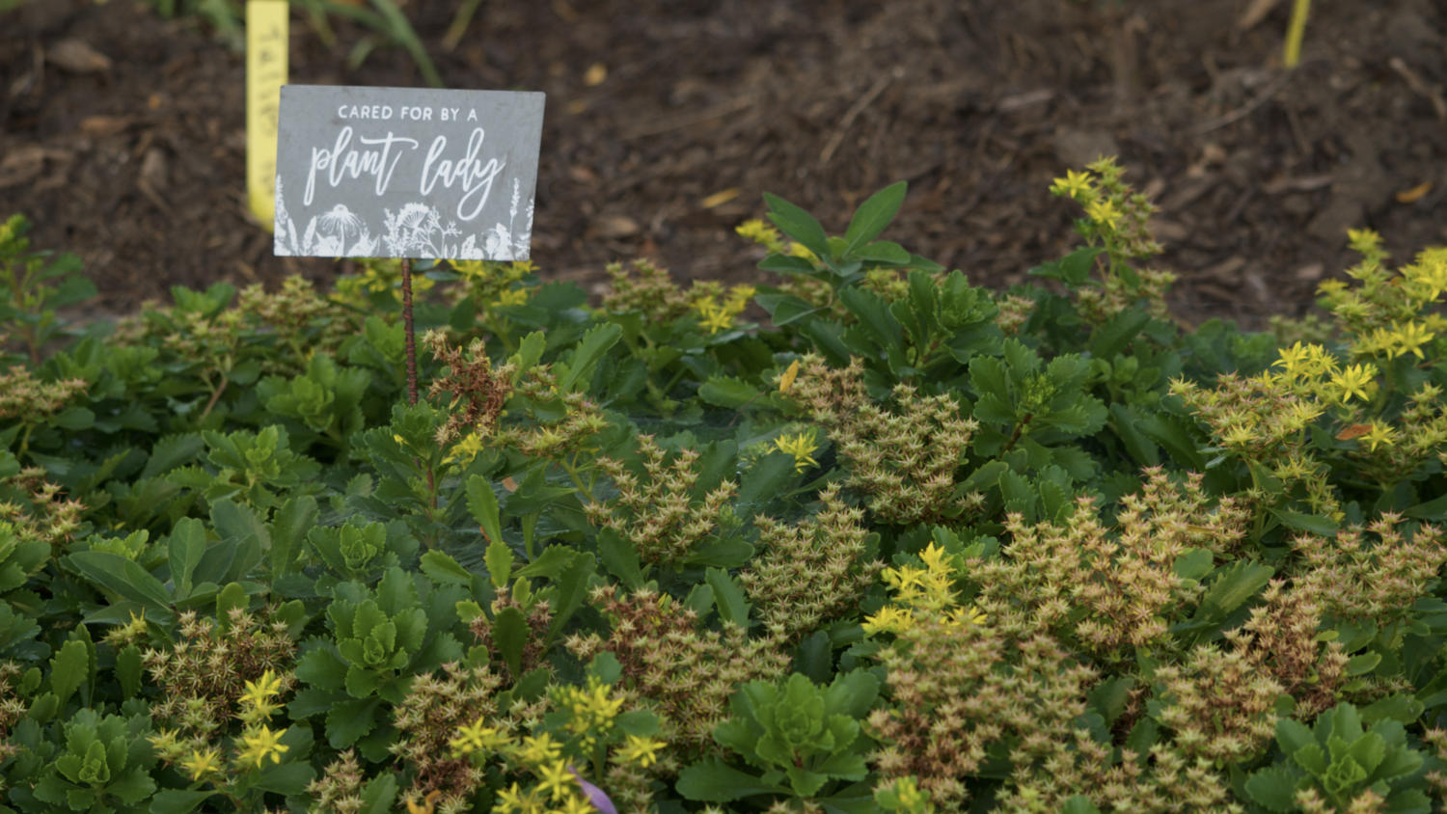

Slide 27
Statement About COVID and The Friends Group
COVID has really changed everything about how we interact day to day, have fun with friends and family, and even conduct business.
The board of the Friends of the Monona Senior Center looks to the future with hope and a promise of having our events return in full force. We appreciate your understanding during these difficult times.

Slide 28
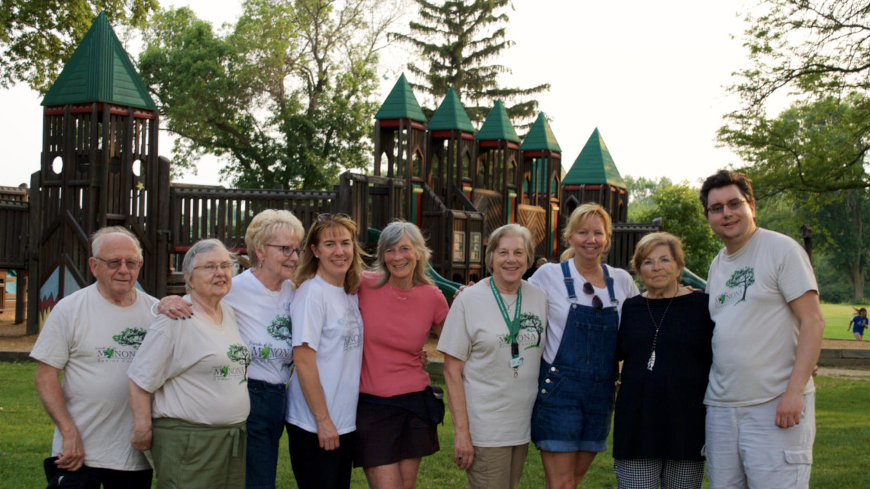
Thank You For Attending!

